Slide 1

Adverbs of Manner

Slide 2
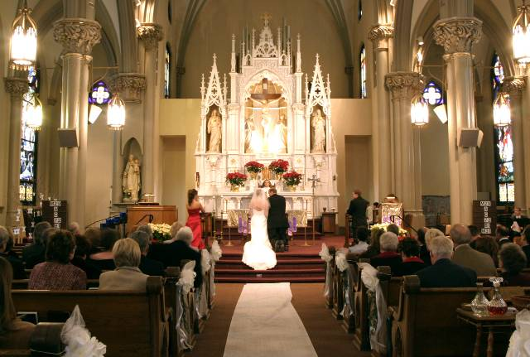
14-9 LINKING VERBS + ADJECTIVES
The wedding was lovely.

Slide 3
14-9 LINKING VERBS + ADJECTIVES
BE + ADJECTIVE
(a) The wedding was lovely.
be + adjective

Slide 4
14-9 LINKING VERBS + ADJECTIVES
STATIVE + ADJECTIVE
VERB
(b) The band sounded terrific.
(c) The girl looked beautiful.
(d) The food tasted delicious.
(e) The bouquet smelled fresh.
(f) Everyone felt happy.
common stative verbs: look, smell,
feel, taste, and sound

Slide 5
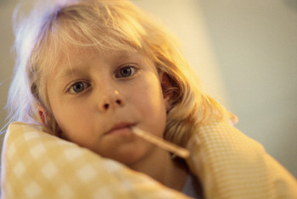
14-9 Let’s Practice
good calm terrific
happy sick fine
Marisa feels ____.
sick

Slide 6

14-9 Let’s Practice
John got a great new job.
He feels _____ .
bad
calm
sick
lazy
happy
terrible
happy

Slide 7
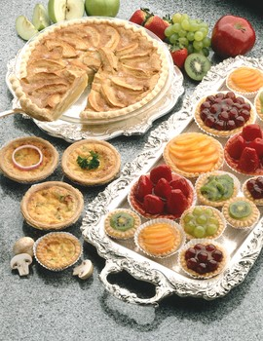
14-9 Let’s Practice
All of these things ____________.
look delicious
look salty
look terrible
look delicious
smell bad

Slide 8
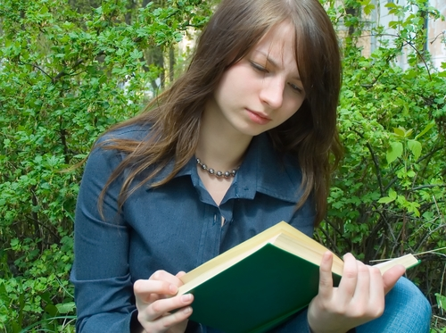
14-10 ADJECTIVES AND ADVERBS
Katya is a slow reader.

Slide 9
14-10 ADJECTIVES AND ADVERBS
(a) Ada is a slow reader.
(b) Ada reads slowly.
adjective noun
adverb action
ADJECTIVES
ADVERBS
careful
slow
quick
easy
carefully
slowly
quickly
easily

Slide 10
14-10 ADJECTIVES AND ADVERBS
(c) Len is a fast runner.
(d) Len runs fast.
ADJECTIVES
ADVERBS
fast
hard
early
late
fast
hard
early
late

Slide 11
14-10 ADJECTIVES AND ADVERBS
(e) Lou is a good runner.
(f) Lou runs well.
ADJECTIVE
ADVERB
good
well

Slide 12
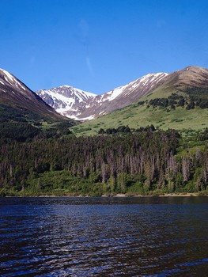
14-10 Let’s Practice
clear clearly
I can see ______.
It is a _____ day.
clearly
clear

Slide 13
14-10 Let’s Practice
easy easily
When you study enough, exams are _____.
easy

Slide 14
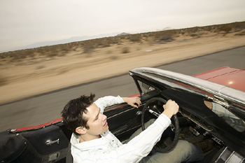
14-10 Let’s Practice
careful carefully
Everyone should be ______ when they drive.
careful
Everyone should drive _______.
carefully

